Slide 1

Department of Computer Science
BSc (Hons) Computer Science
Academic Year 2024/2025
Machine Learning model For Predicting House Rent Prices in Ibadan: A data driven approach
Rotimi Israel Taye
E047849
Supervisor: Mr Abiola

Slide 2
Background of the Study
Rent refers to a certain amount of money paid periodically by the tenant to the landlord in consideration for the occupation and use of the landlord’s property (Onyejiaka et al., 2025).
Linear regression is used to model the relationship between a dependent variable and one or more independent variables (Smith et al., 2024).
Traditional pricing methods are subjective and inefficient.

Slide 3
Related Works
S/N | Title / Authors / Year | Methodology | Major Results | Observed Weakness
1 | Integrating Random Forest and XGBoost For Accurate House Rent Prediction Singh et al. (2025) | Ensemble ML integration (Random Forest + XGBoost); regression-based prediction on rental factors (location, area, sq ft, amenities, etc.) | High accuracy in rent value prediction; combined model outperformed individual baselines; effective use of location and structural features as key predictors | High computational cost Computational intensity from ensemble stacking; potential overfitting without careful tuning; dataset-dependent
2 | Real estate decision-making: precision in price prediction through advanced machine learning algorithms (International Journal of Housing Markets and Analysis) (2025) | SVR & Gradient Boosting Machine (GBM) | RReduced bias vs. traditional methods; high accuracy in valuation | Focused on specific region (e.g., Amman); may need adaptation elsewhere
3 | Enhancing house price forecasting with hybrid data driven feature extraction model (Journal of the Operational Research Society) (2025) | Hybrid VMD-RF feature extraction + SVR/LSTM | High R² (0.97); unified health index improves prediction | Relies on specific decomposition; potential complexity in hybrid setup

Slide 4
Statement of Problem
Traditional housing price valuation methods are often subjective, time-consuming, and prone to inconsistency, as they rely heavily on human judgment and limited market information. Addressing the limitations of housing evaluation involves the development of a data-driven rent prediction system using a linear regression model trained on historical housing data.

Slide 5
AIM AND OBJECTIVES
The aim is to develop a Linear Regression model for predicting house rent prices in Ibadan.
The objectives of this project are:
To collect raw data from house agents and couple it with online data from secondary sources, preprocess and feature scaling to ensure data quality.
To develop a machine learning-based model for predicting house rent using relevant housing features.
To evaluate the performance and effectiveness of the developed linear regression model using appropriate statistical metrics

Slide 6
Problems of Existing System
Subjective pricing
Time-consuming process
Inconsistent valuation
Poor scalability

Slide 7
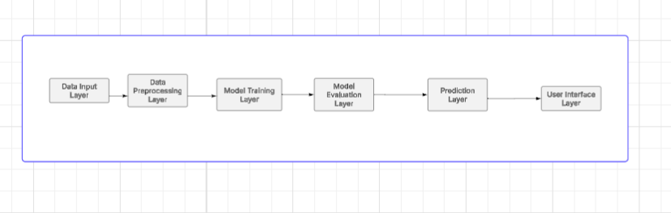
System Architecture

Slide 8
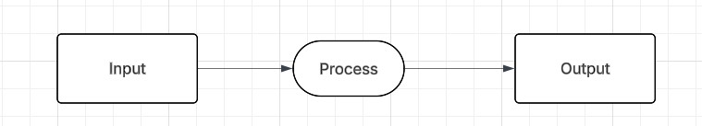
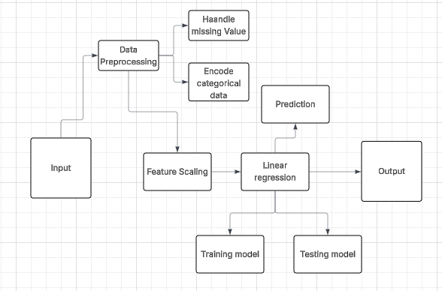
Data Flow Diagram
Level 0
Level 1

Slide 9
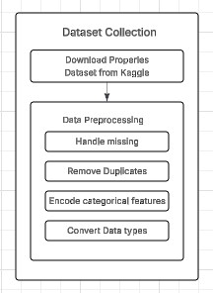
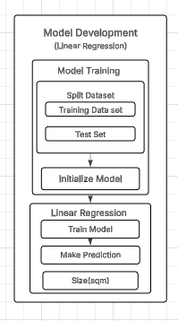
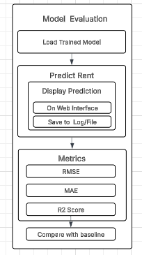
Methodology
Data collection and
preprocessing
Model Development
Model Evaluation

Slide 10
Methodology
Data Collection: Housing rental dataset was obtained from Secondary sources and relevant features.
Data Preprocessing & Preparation: Missing values and duplicates were handled, encoding, and StandardScaler. The dataset was split into training and testing sets.
Model Development: A Linear Regression model was trained
Model Evaluation: Model performance was assessed using MAE, RMSE, and R² score to evaluate prediction accuracy and effectiveness.
K-Fold Validation: 5 fold cross-validation was used for robustness.
Deployment: Streamlit web application for user interaction.

Slide 11
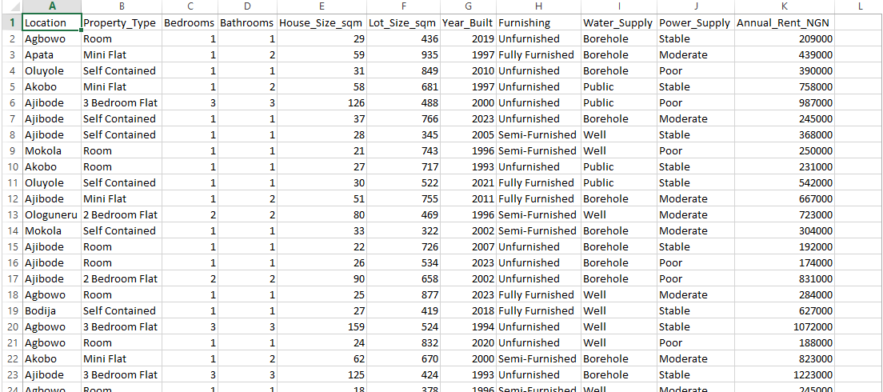
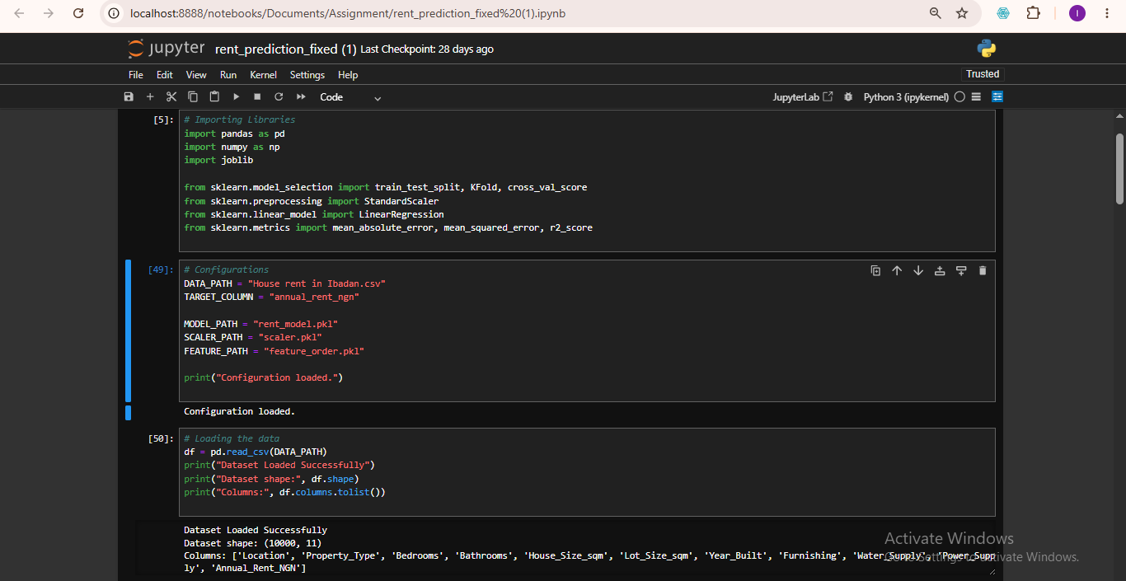
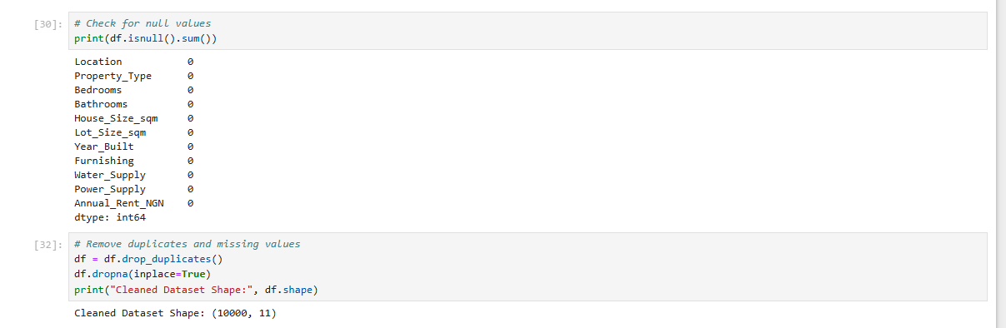
Data Preprocessing & Analysis – Encoding, Scaling & Training
Dataset used for the training the model
Loading the dataset
Checking for Duplicates and Missing Values

Slide 12
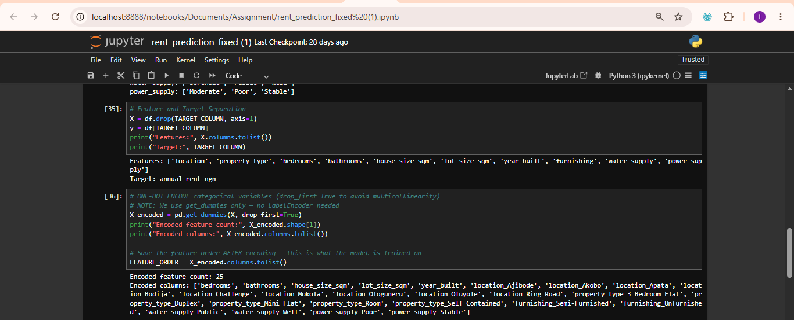
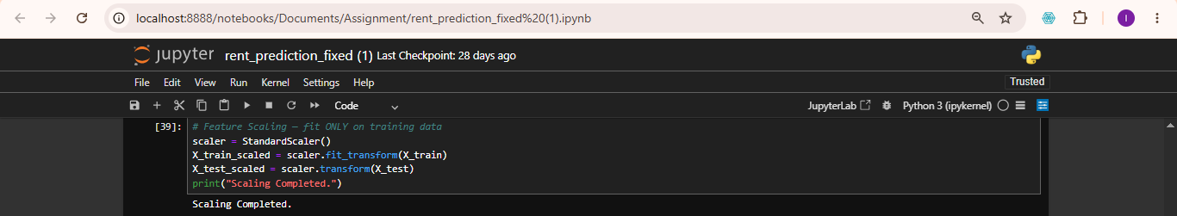
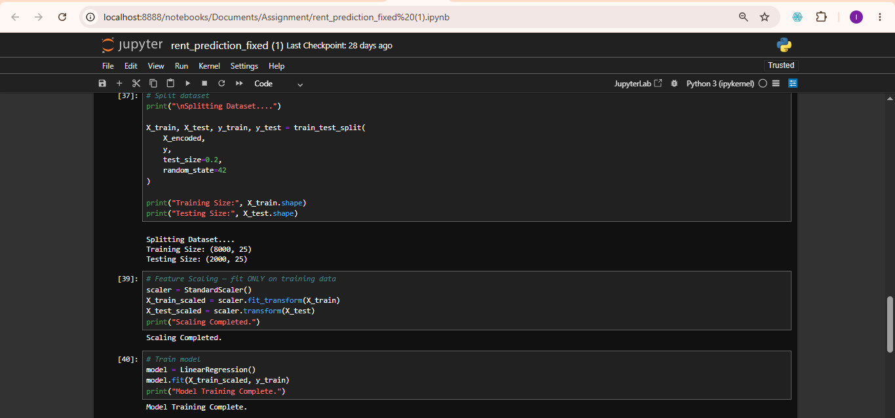
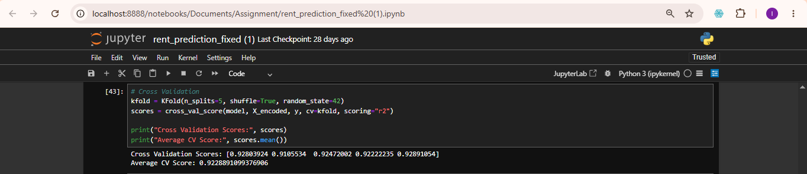
Data Preprocessing & Analysis – Encoding, Scaling & Training
One-Hot Encoding, 25 encoded features
One-Hot Encoding, 25 encoded features
Model Training
K-Fold Cross-Validation Scores: [0.9280, 0.9106, 0.9247, 0.9222, 0.9289] — Avg: 0.9229

Slide 13
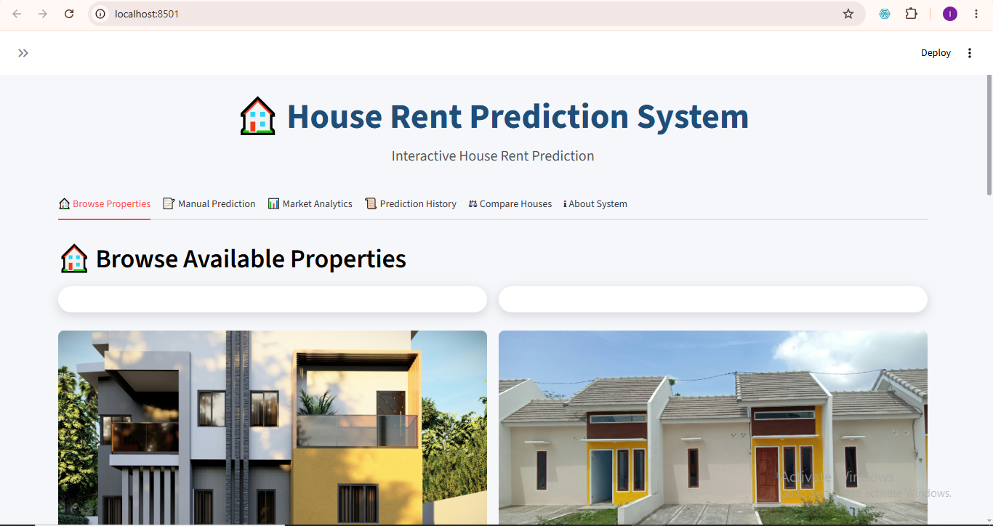
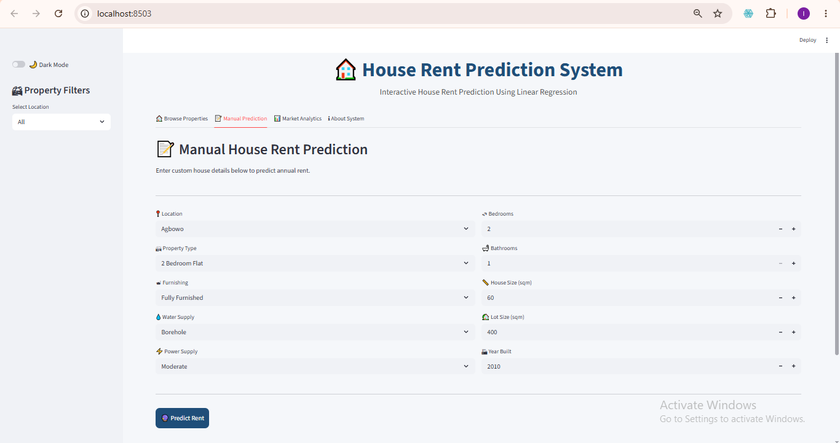
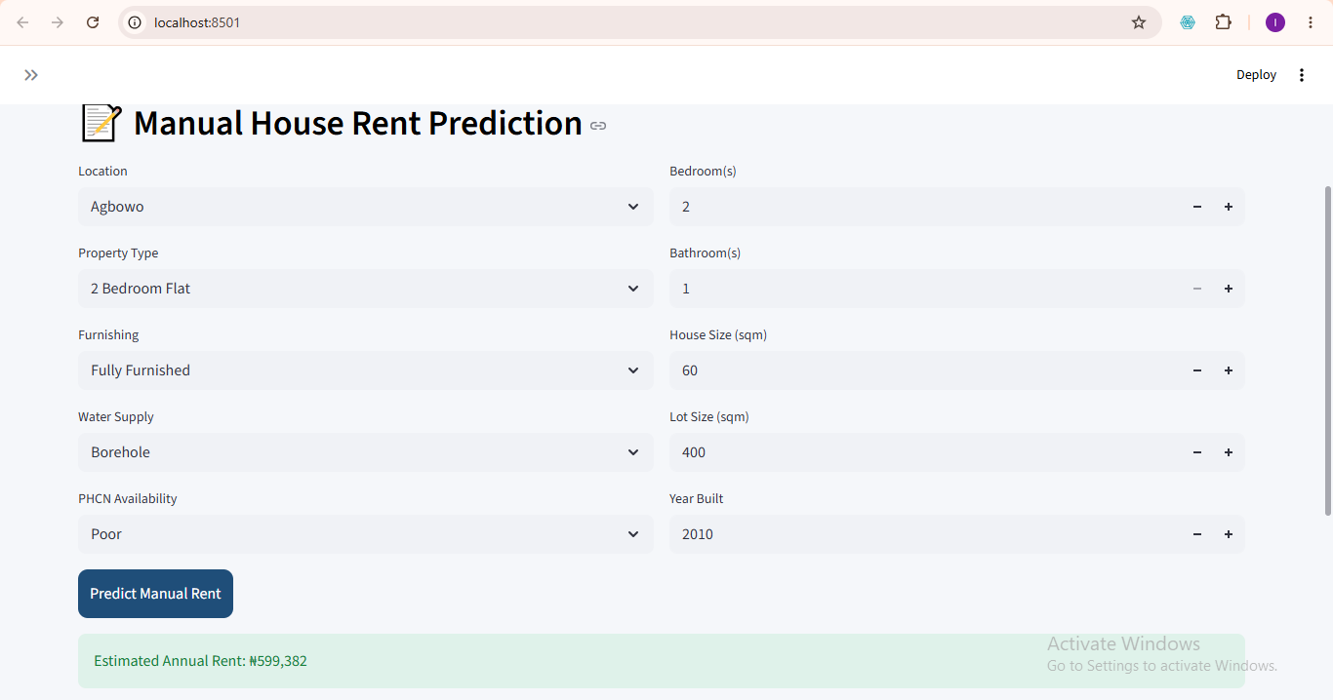
System Interface – Home & Manual Prediction
Manual Prediction Interface
Home Interface (Browse Properties)
Manual Prediction Output

Slide 14
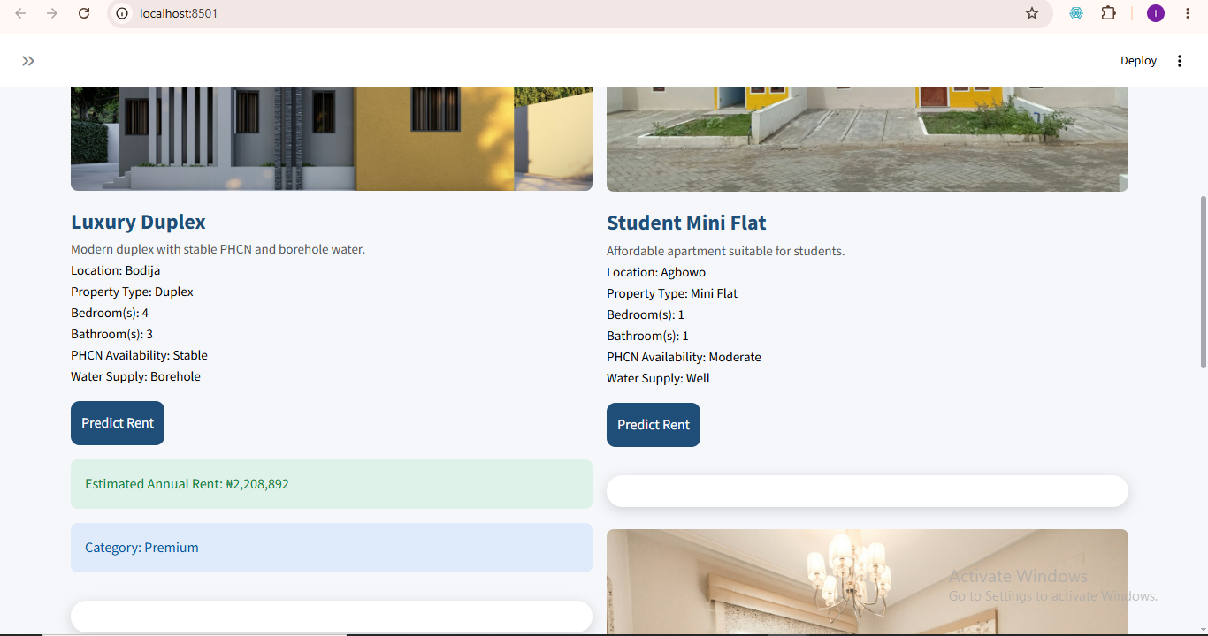
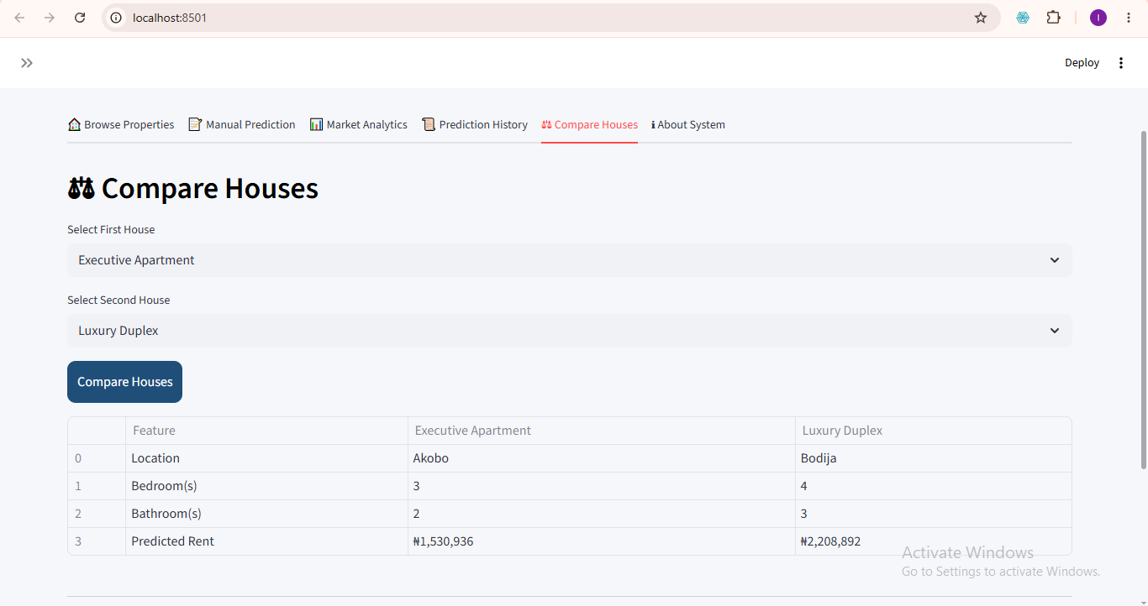
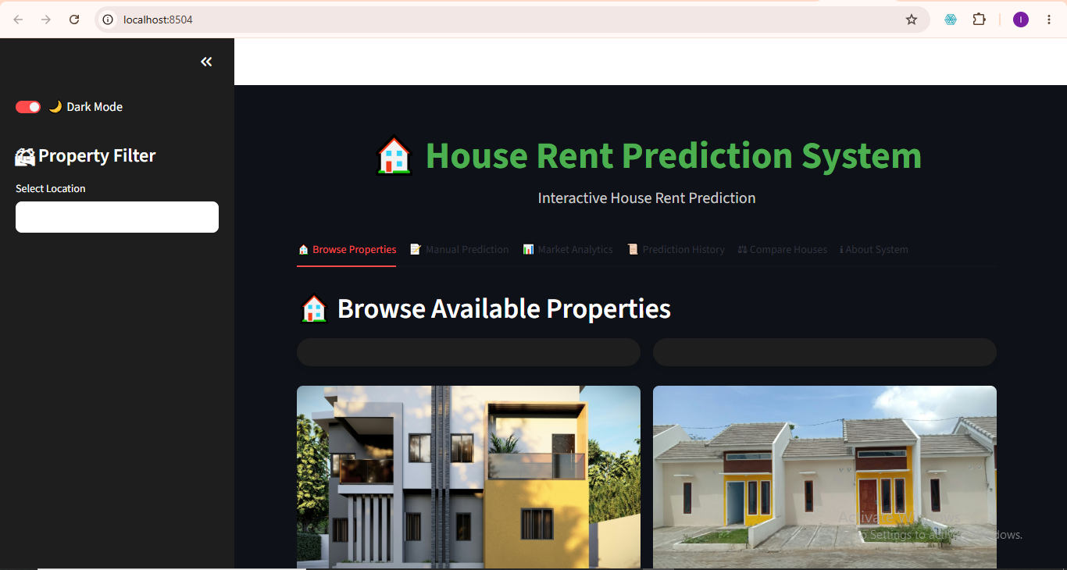
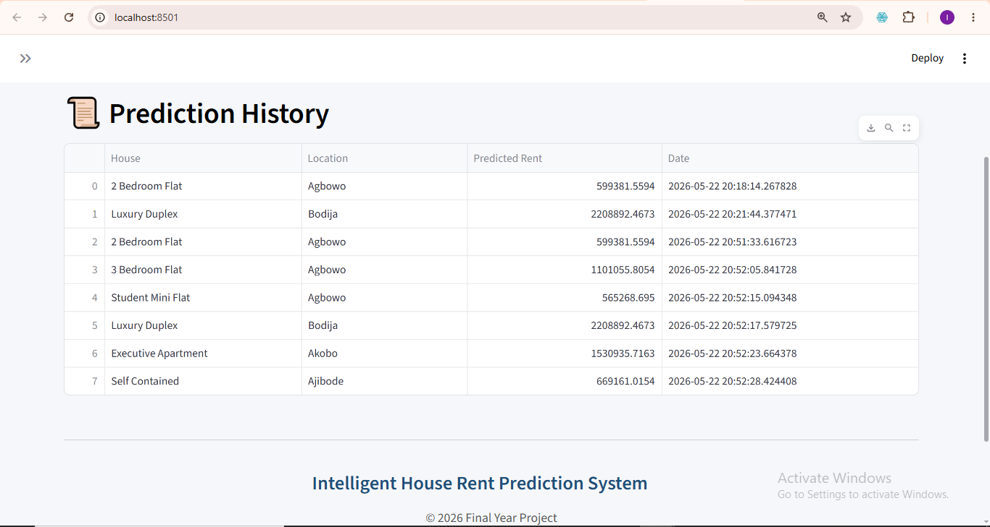
System Interface – Property Gallery, Comparison & History
Property Gallery Interface
House Comparison Interface
Prediction History Interface
Dark Mode Interface

Slide 15
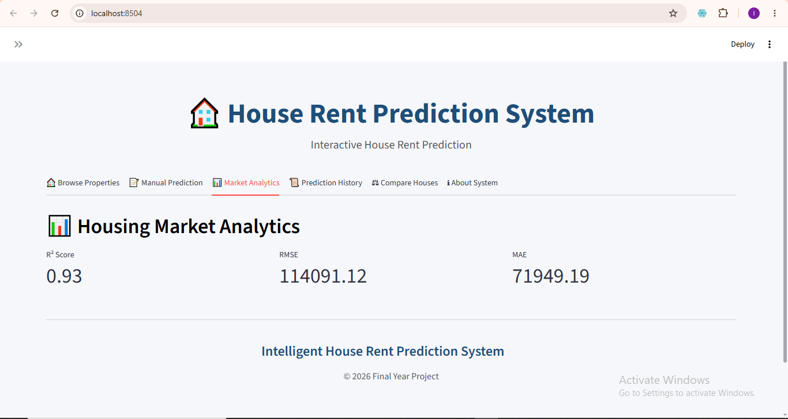
System Interface – Market Analytics
Market Analytics Interface

Slide 16
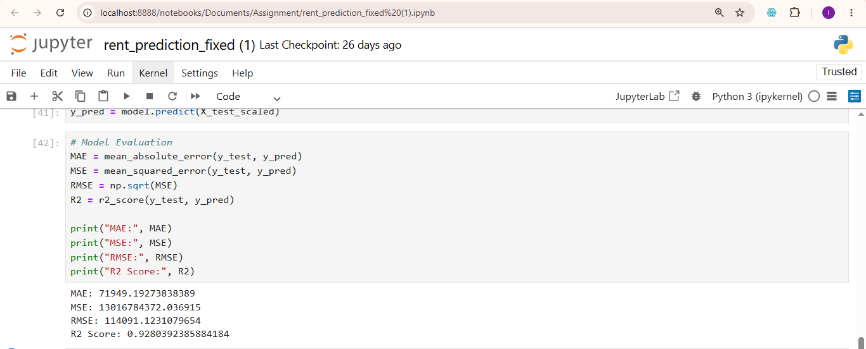
Model Evaluation Results
Model Evaluation Output (MAE, MSE, RMSE, R² Score)
K-Fold Cross-Validation Scores

Slide 17
Conclusion & Recommendations
Conclusion
Localized rent prediction model for Ibadan
Integrated ML with Interactive Streamlit UI
Combined agent data with secondary datasets
Applied K-fold validation for reliability
Introduced visual property exploration
Recommendations
Explore advanced models (Random Forest, XGBoost)
Expand dataset coverage to more cities
Integrate GIS for map-based visualization
Include socio-economic variables
Connect to real-time housing platforms

Slide 18
References
Onyejiaka, J. C., Onyima, C. N., & Okafor, J. I. (2025). Examination of factors that lead to rent default on selected residential properties in Awka, Anambra State. International Journal of Real Estate, 1(1), 65–79. “Rent refers to a certain amount of money paid periodically…” (p. 66)
Smith, J. A., Brown, L. M., & Lee, R. K. (2024). Applying linear regression to housing rent determinants. Journal of Housing Economics, 12(3), 45–60. https://doi.org/10.1234/jhe.2024.009

Slide 19
References
Singh, H. V., Srivastava, S. K., Pandey, N. K., & Kumar, N. (2025). Integrating Random Forest and XGBoost for accurate house rent prediction. In 2025 International Conference on ... (Proceedings). IEEE. https://doi.org/10.1109/... (or see IEEE Xplore: https://ieeexplore.ieee.org/document/10939118)
Shbool, M. A., Al-Dmour, R., Al-Shboul, B. A., Albashabsheh, N. T., & Almasarwah, N. (2025). Real estate decision-making: Precision in price prediction through advanced machine learning algorithms. International Journal of Housing Markets and Analysis. Advance online publication. https://doi.org/10.1108/IJHMA-01-2025-0004
Soon, K. L., Soon, L. T., & Teo, J. Y. (2025). Enhancing house price forecasting with hybrid data driven feature extraction model. Journal of the Operational Research Society, 76(6), 1–12. https://doi.org/10.1080/01605682.2025.2513449

Slide 20
References
Hermans, L. D., McCord, M. J., Davis, P. T., & Bidanset, P. E. (2023). An exploratory approach to composite modelling for real estate assessment and accuracy. Journal of Property Tax Assessment & Administration, 20(1), 39–56. https://researchexchange.iaao.org/jptaa/vol20/iss1/4
Geerts, M., vanden Broucke, S., & De Weerdt, J. (2023). A survey of methods and input data types for house price prediction. ISPRS International Journal of Geo-Information, 12(5), 200. https://doi.org/10.3390/ijgi12050200
Hussain, M. I., Munir, A., Mamun, M., Chowdhury, S. H., Uddin, N., & Hossain, M. M. (2025). A transparent house price prediction framework using ensemble learning, genetic algorithm-based tuning, and ANOVA-based feature analysis. FinTech, 4(3), 33. https://doi.org/10.3390/fintech4030033

Slide 21
Thank You For Listening

